Slide 1
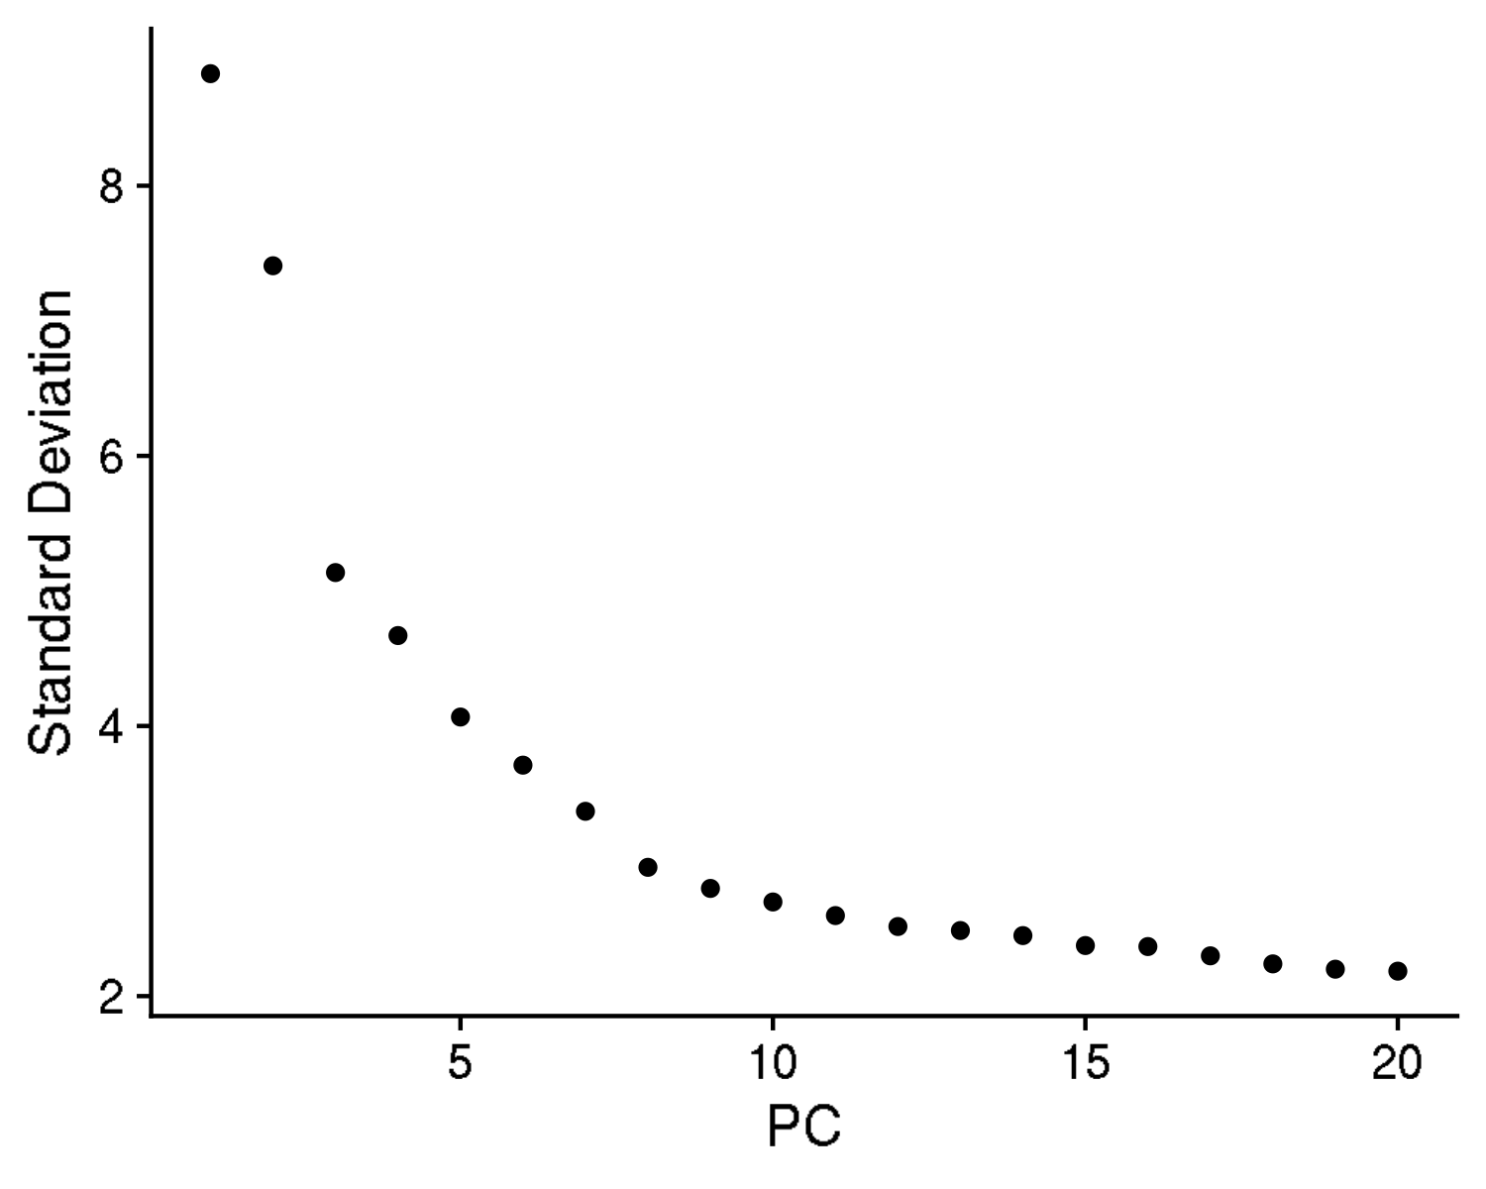
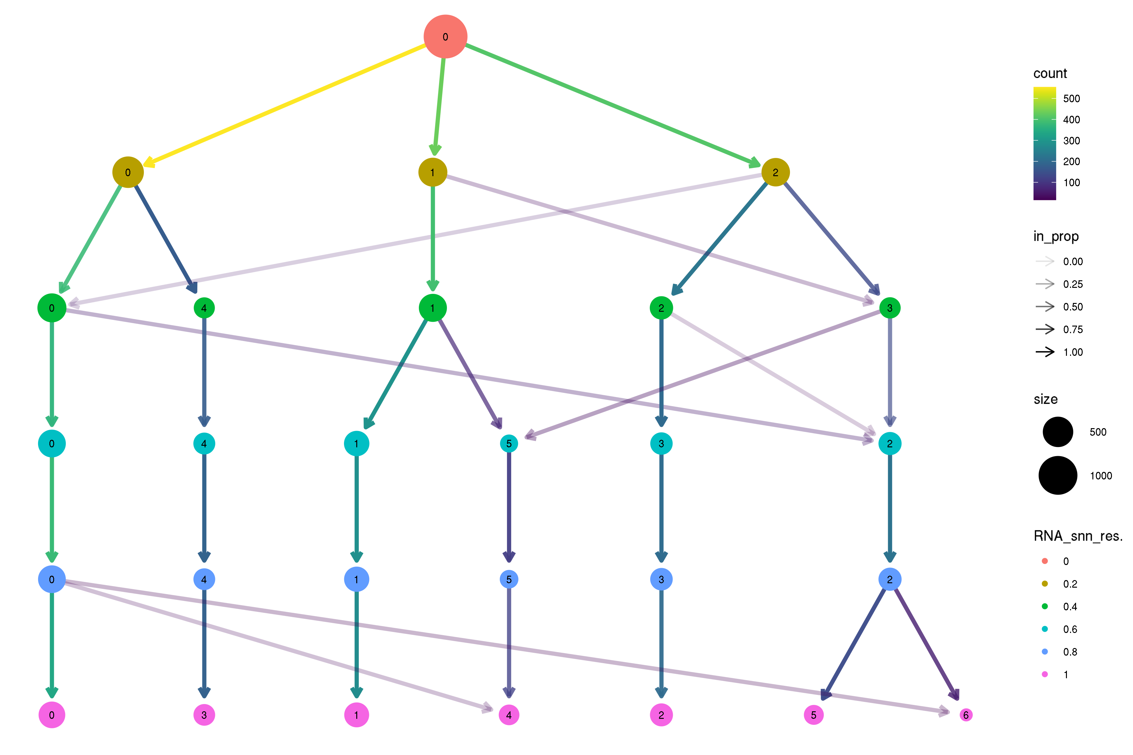
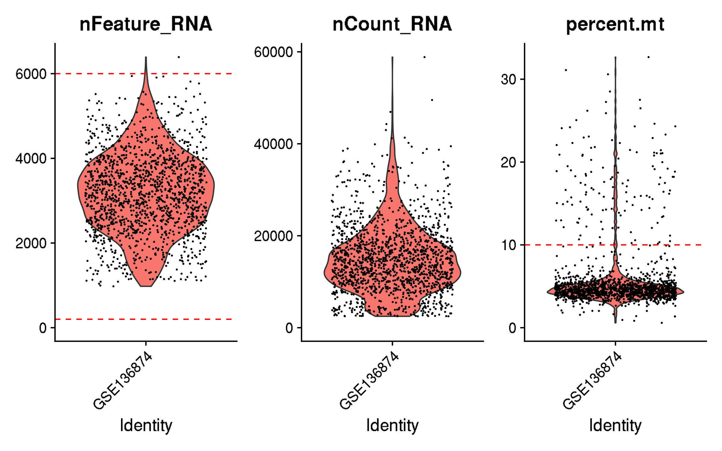
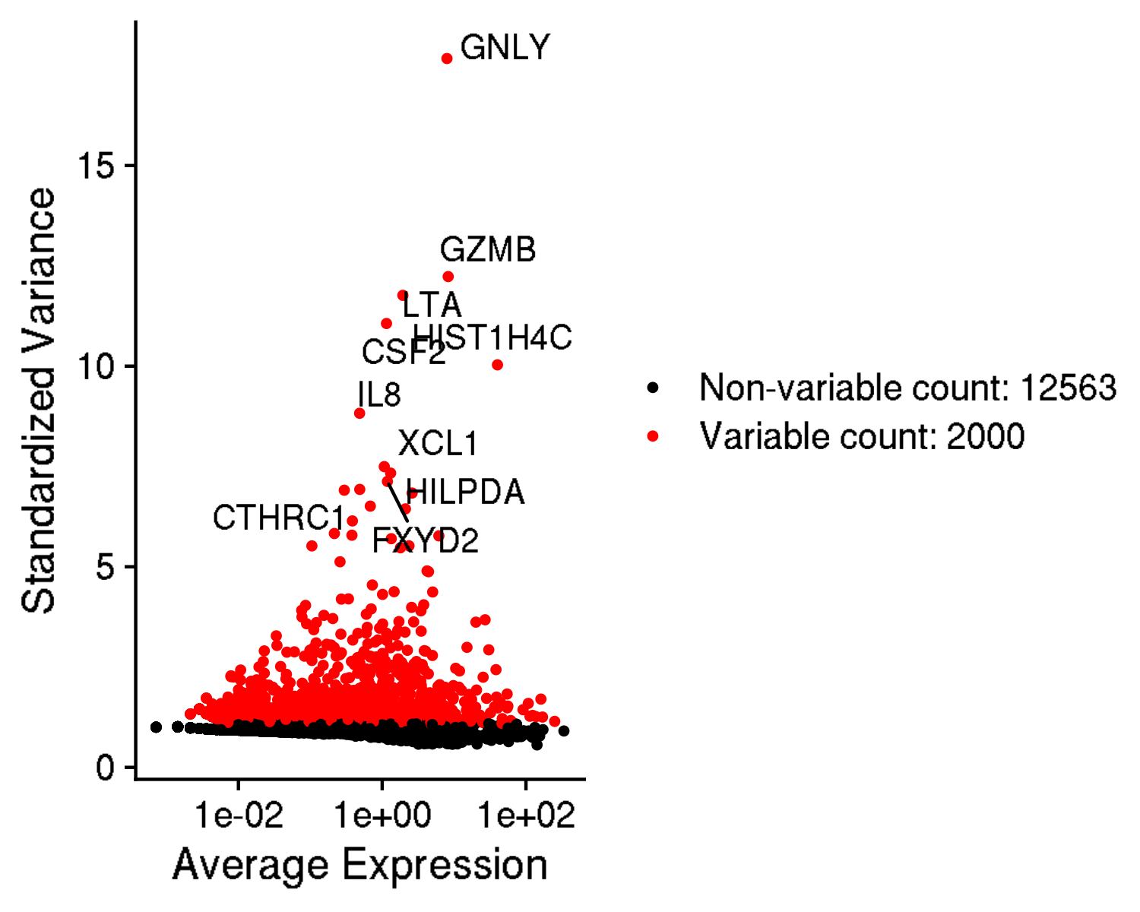
GSE136874: comparison of CD19 and GD2 CAR T cells on day 10 in culture
Inspection and quality control

Slide 2
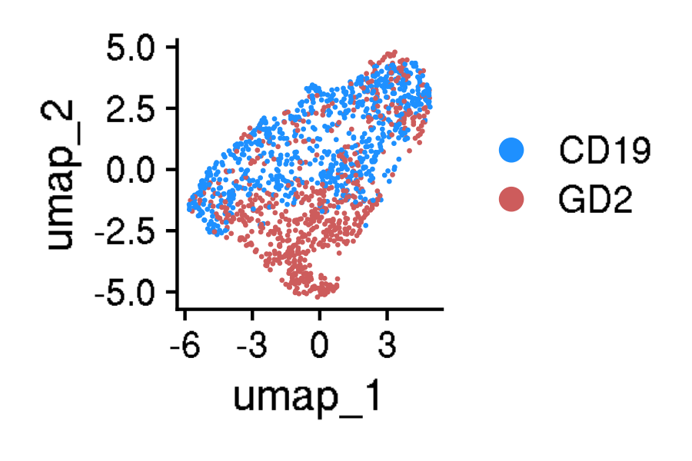
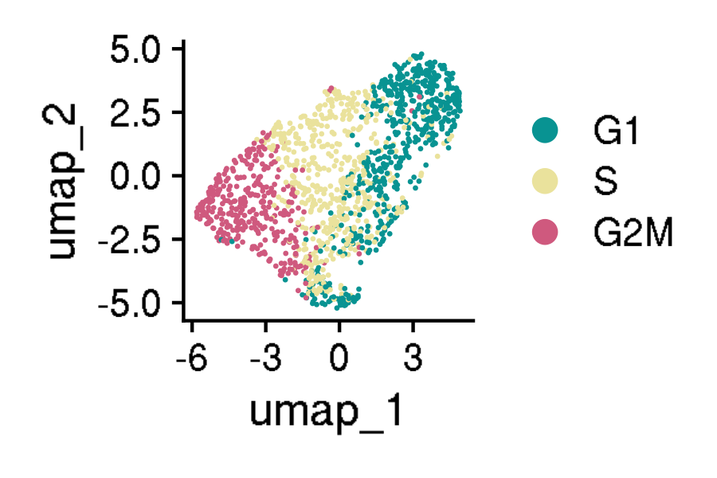
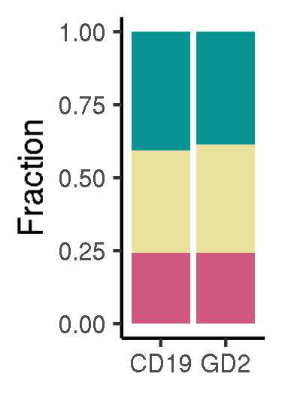
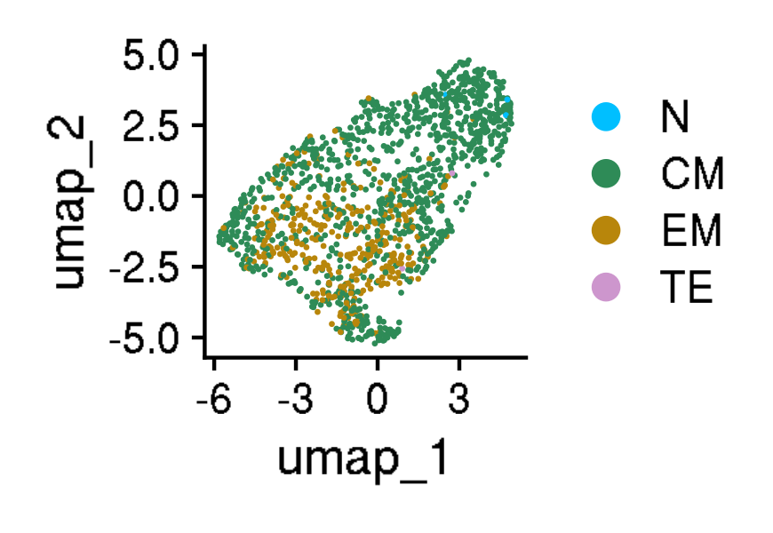
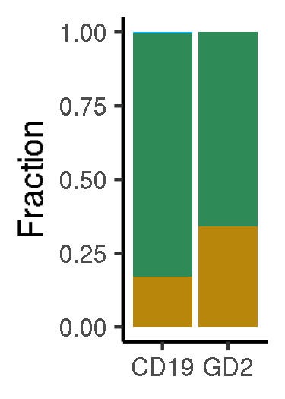
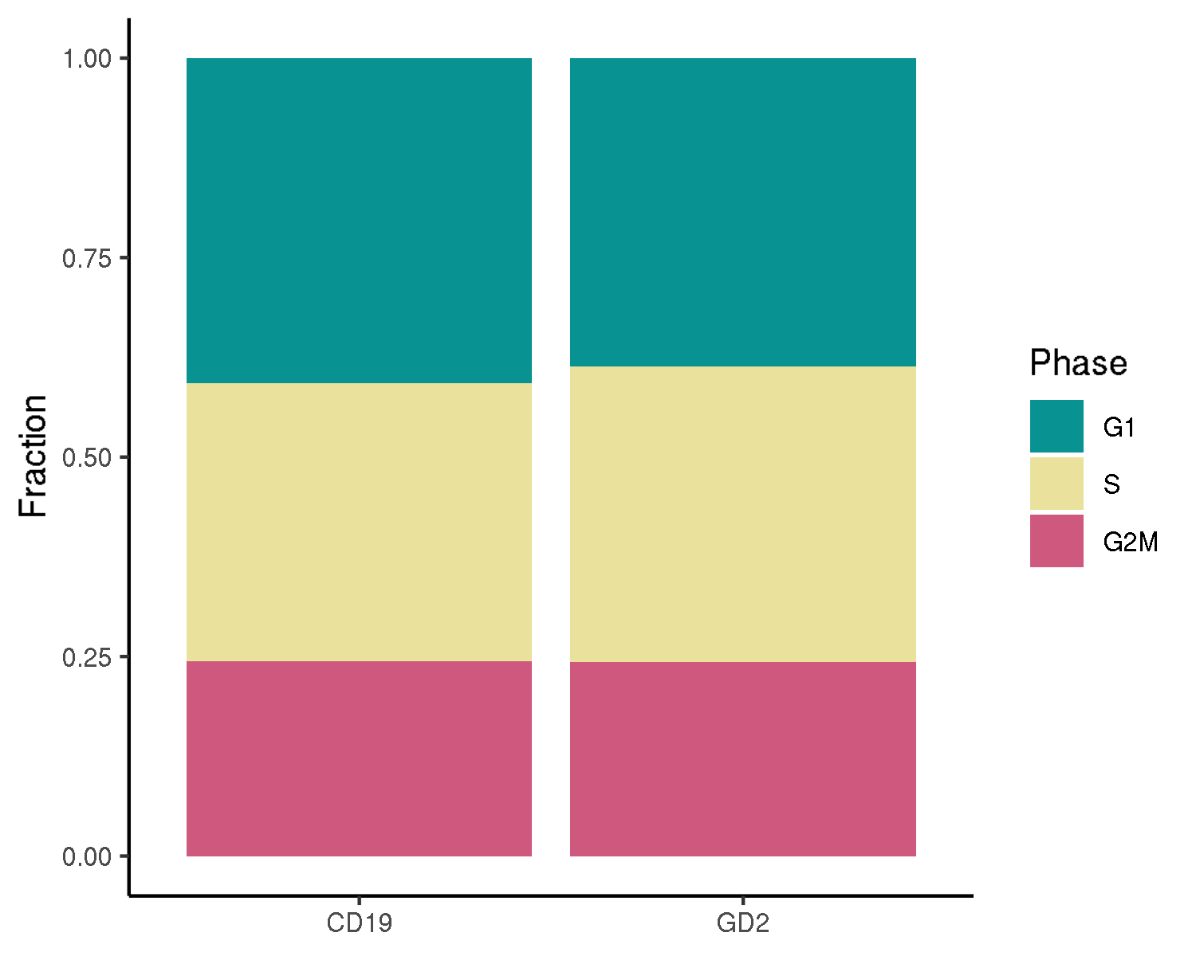
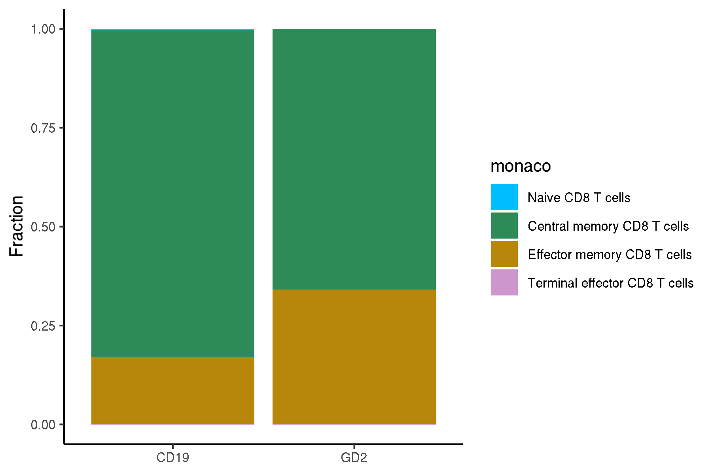
GSE136874: comparison of CD19 and GD2 CAR T cells on day 10 in culture
UMAPs for cell annotations

Slide 3
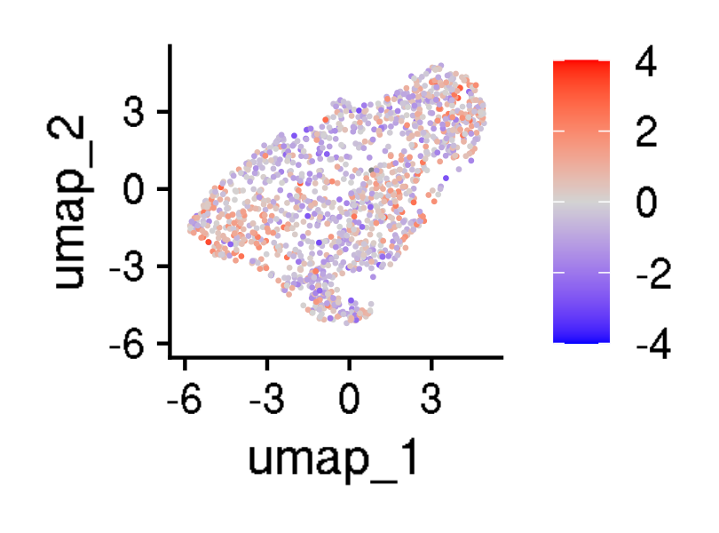
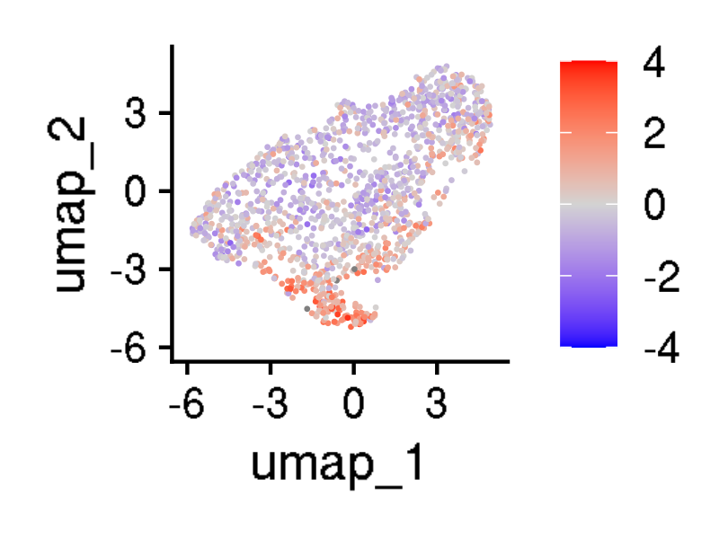


GSE136874: comparison of CD19 and GD2 CAR T cells on day 10 in culture
UMAPs for cell states

Slide 4
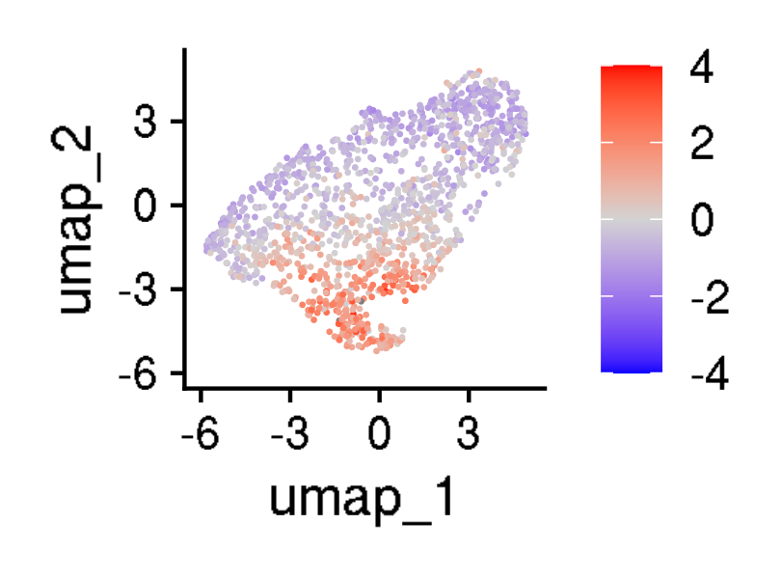


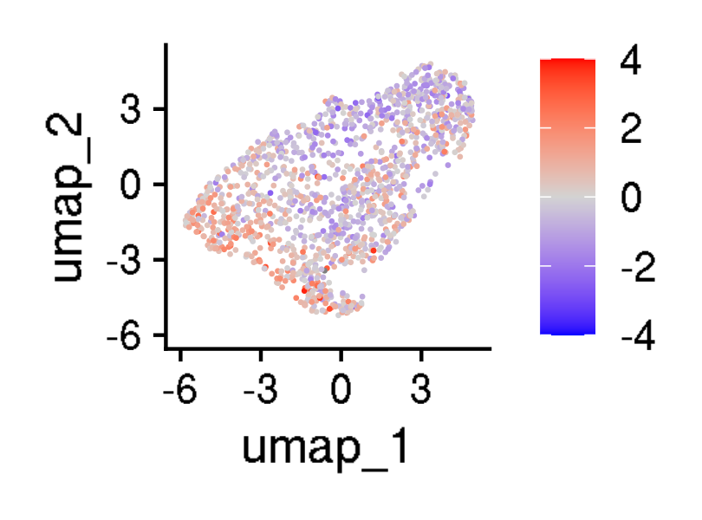
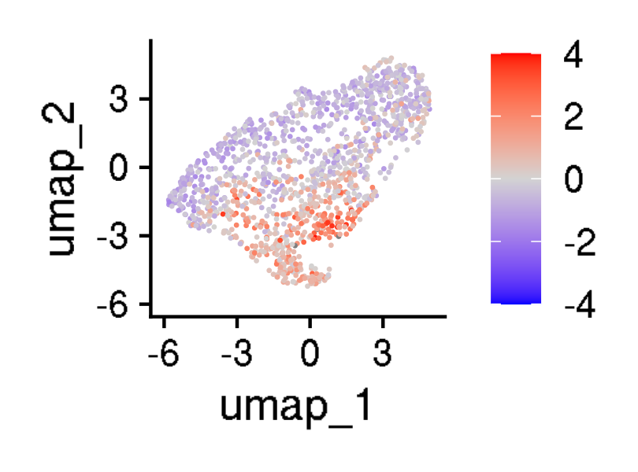
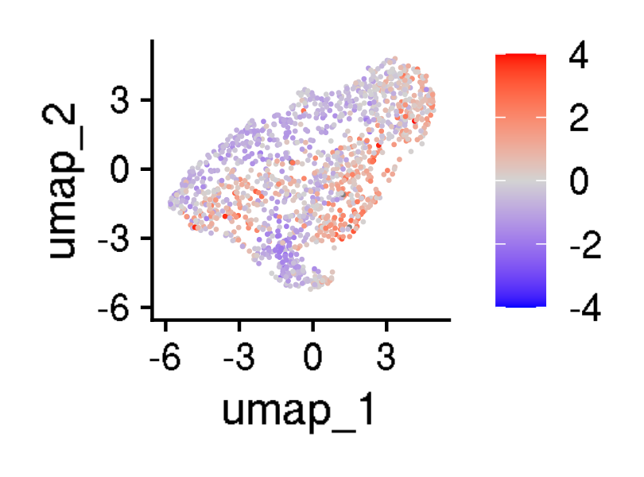
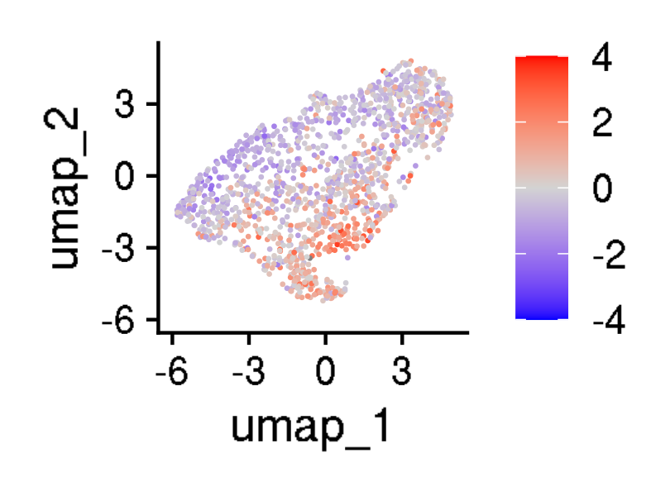
GSE136874: comparison of CD19 and GD2 CAR T cells on day 10 in culture
UMAPs for exhaustion scores

Slide 5
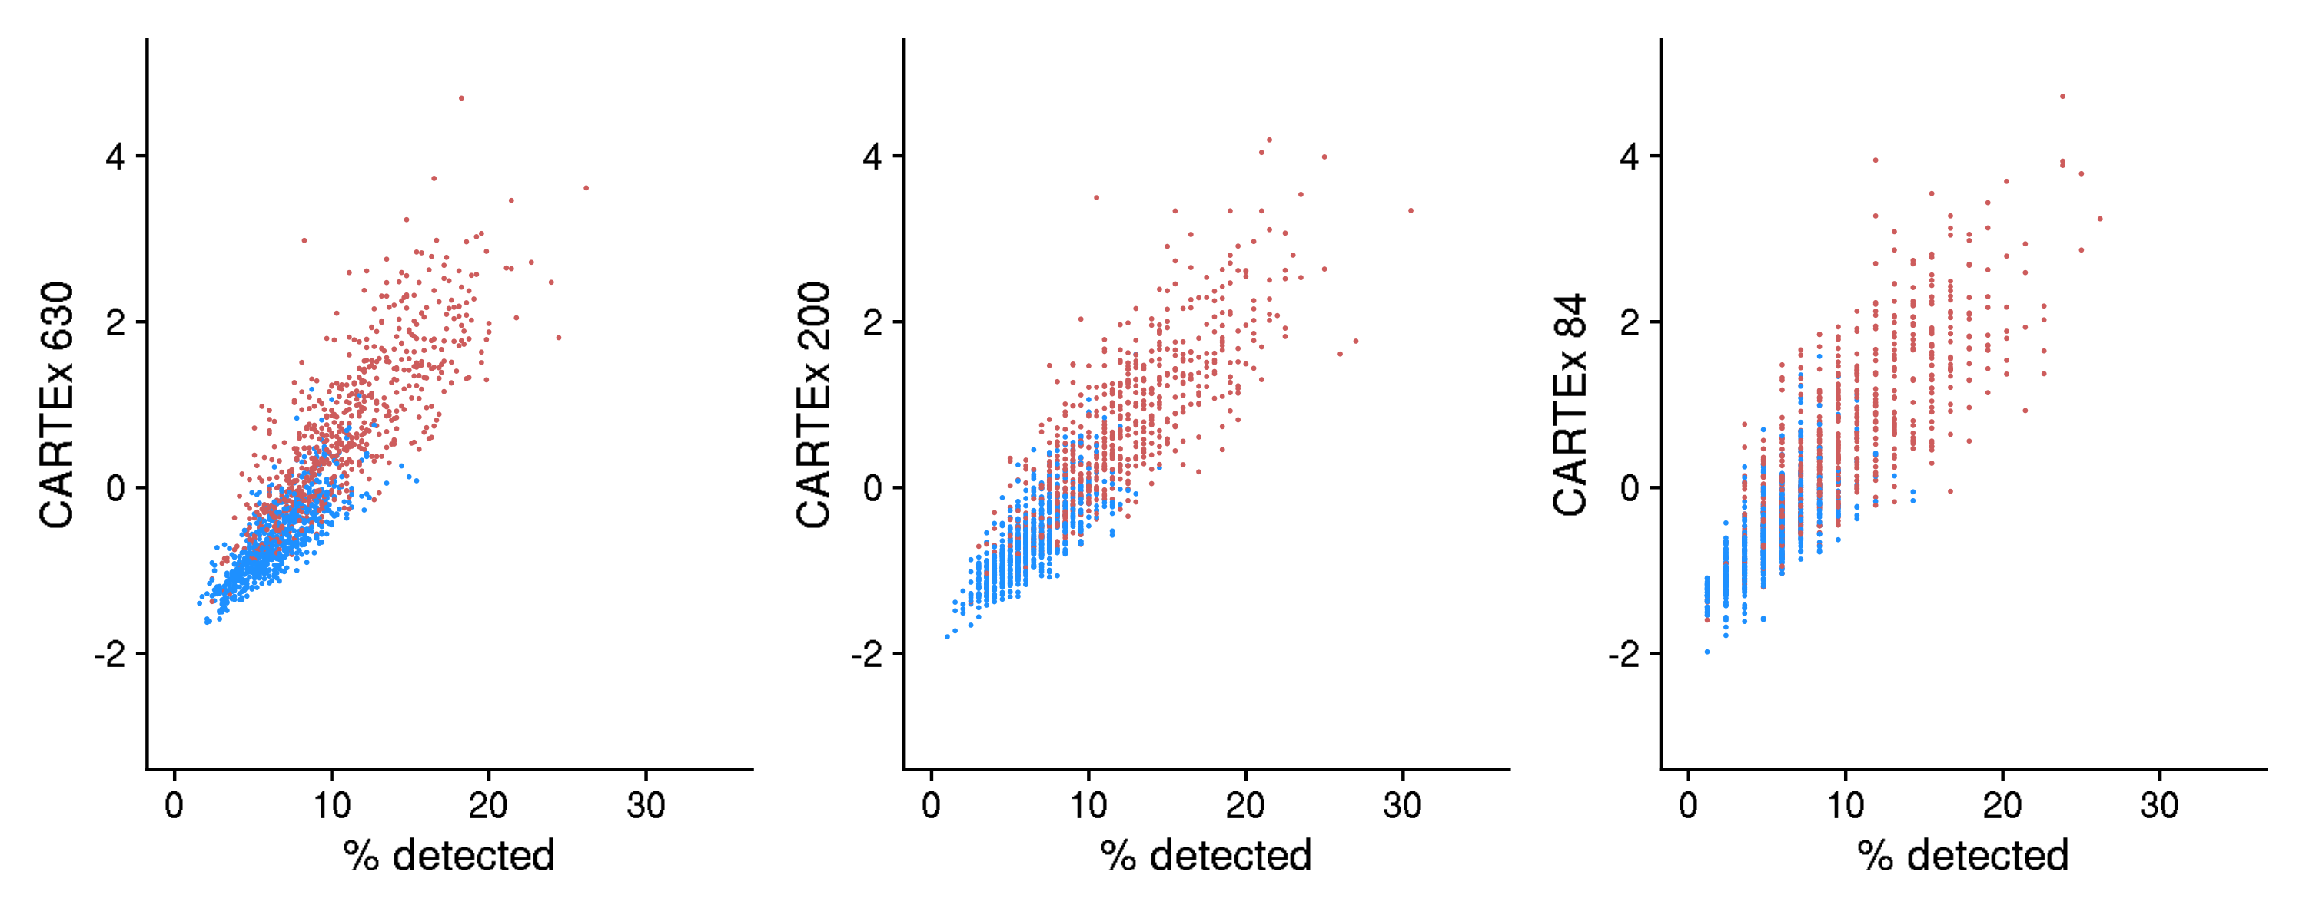
GSE136874: comparison of CD19 and GD2 CAR T cells on day 10 in culture
Percentage of CARTEx detected

Slide 6
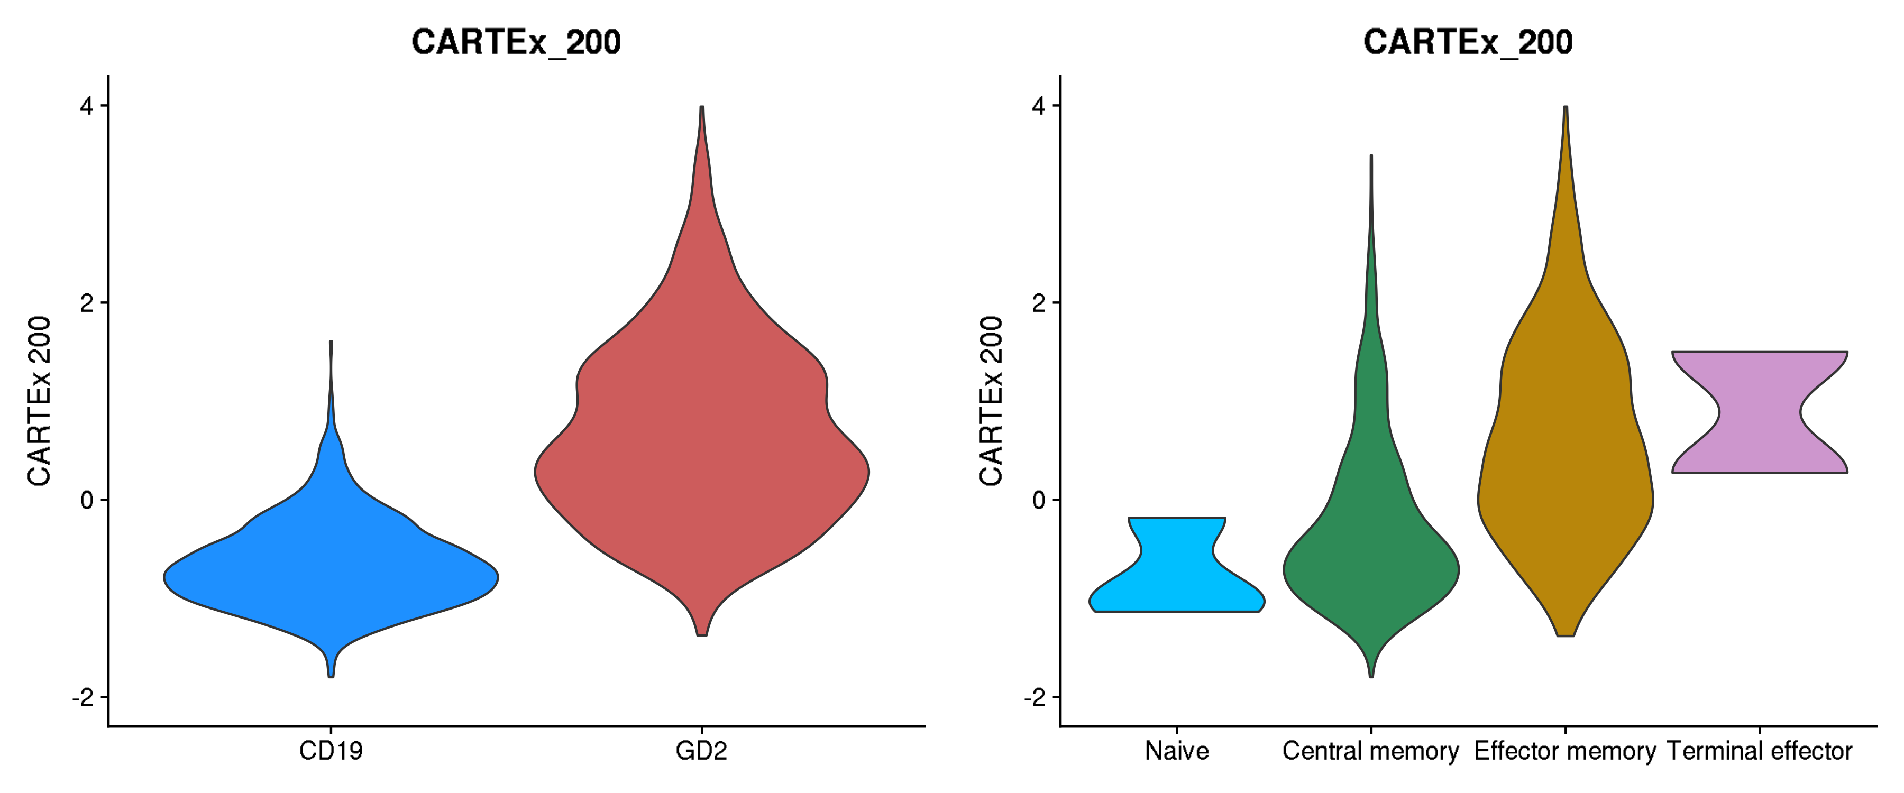
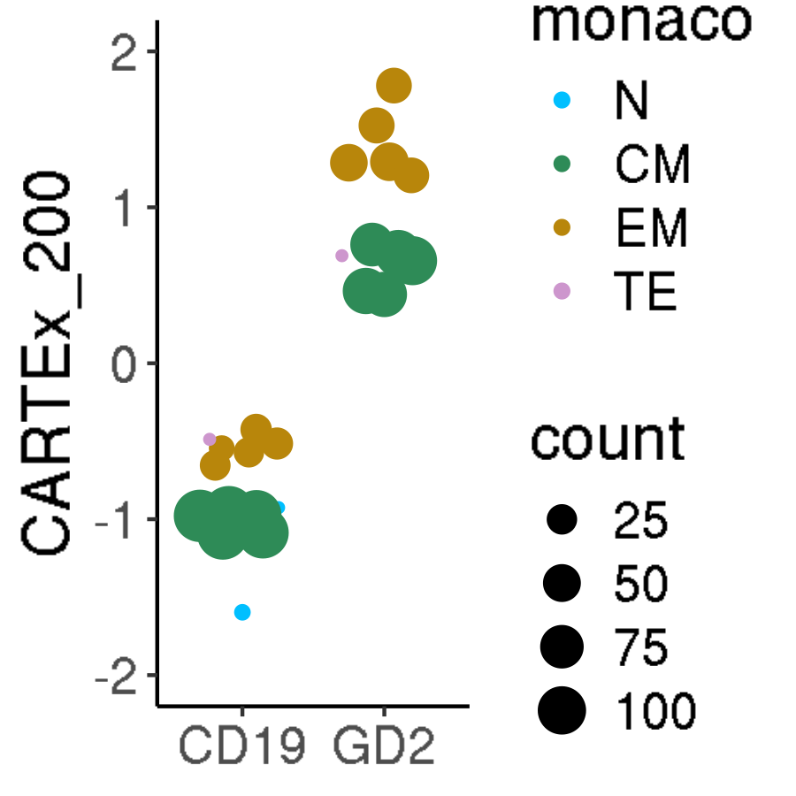
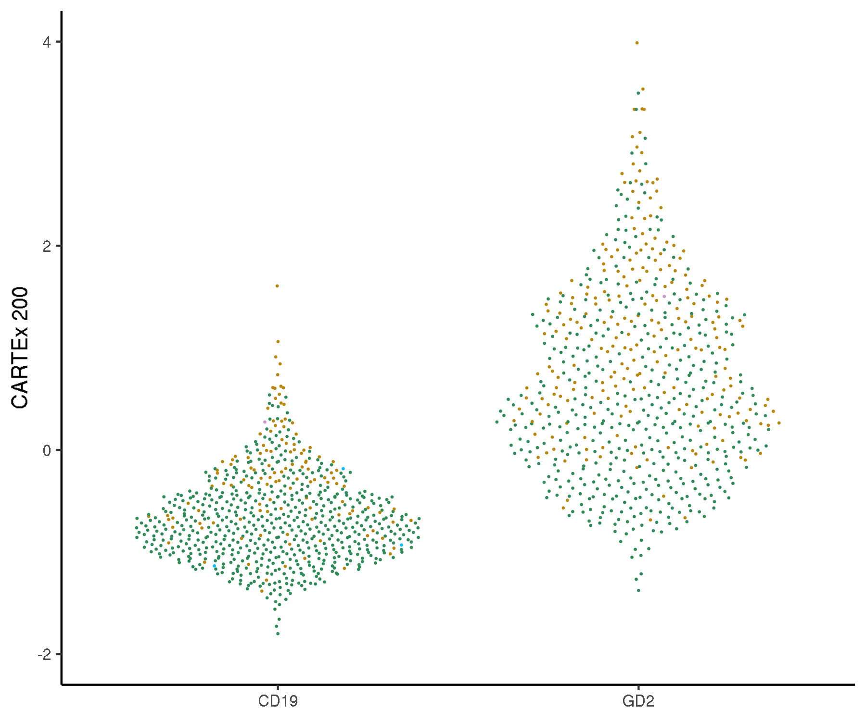
GSE136874: comparison of CD19 and GD2 CAR T cells on day 10 in culture
Cell type differentiation

Slide 7
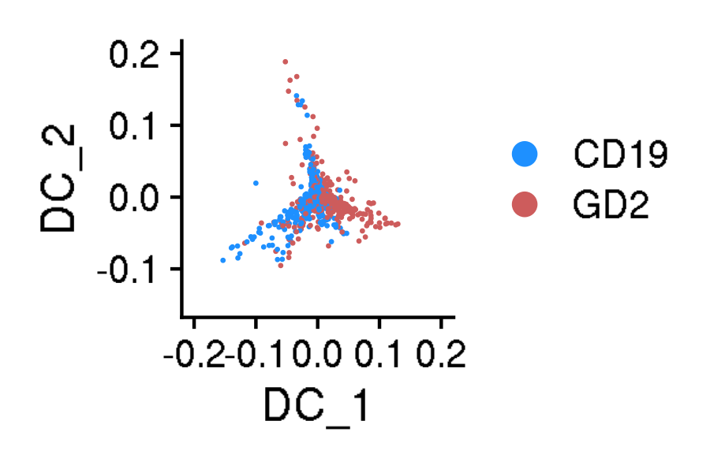
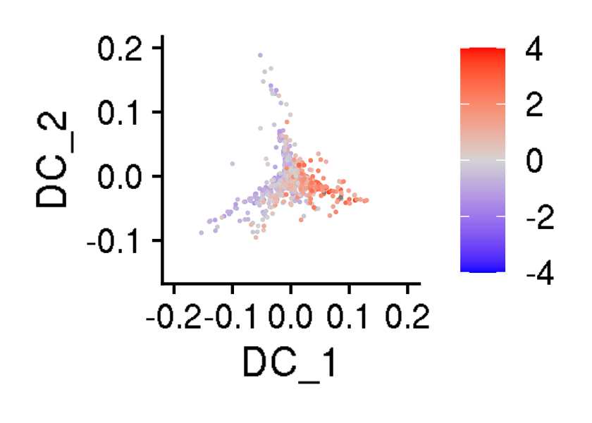





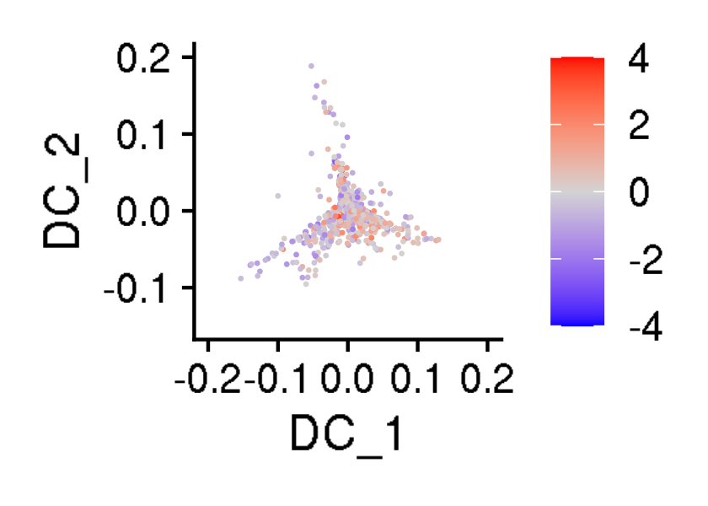
GSE136874: comparison of CD19 and GD2 CAR T cells on day 10 in culture
Diffusion maps

Slide 8
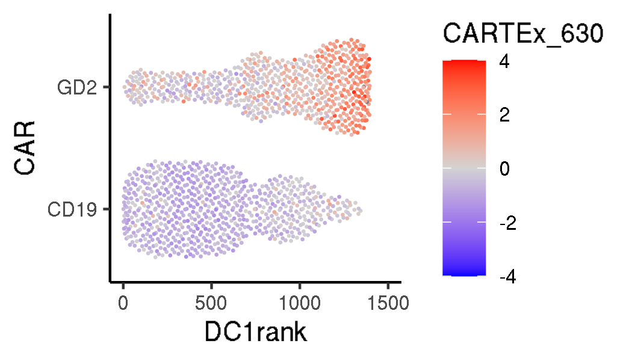

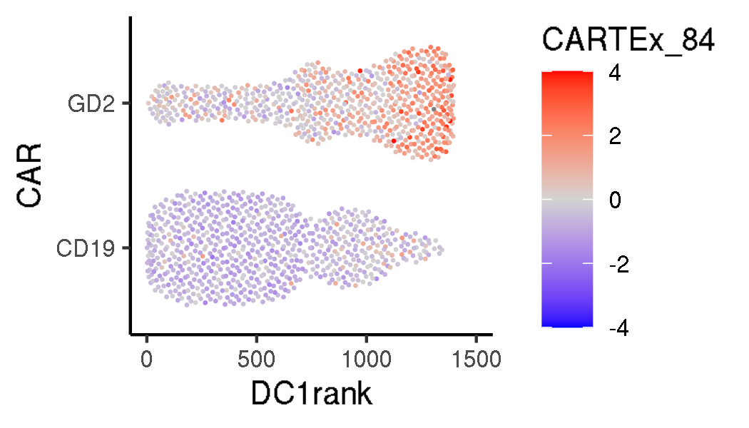
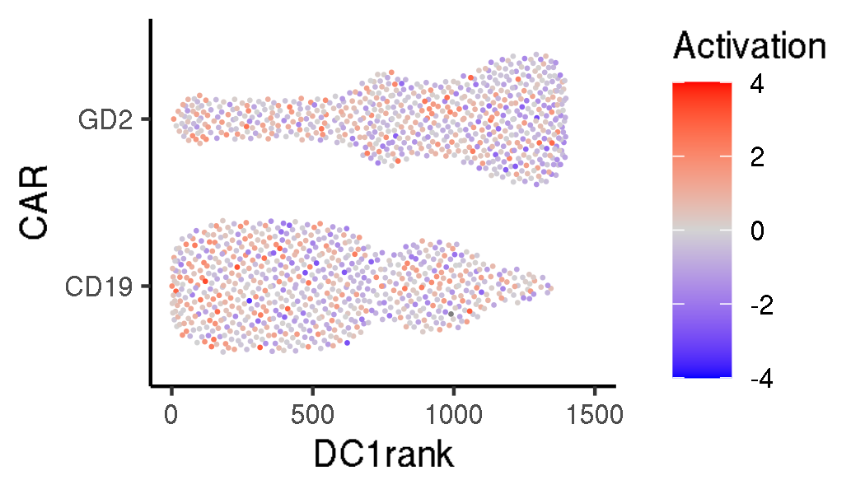
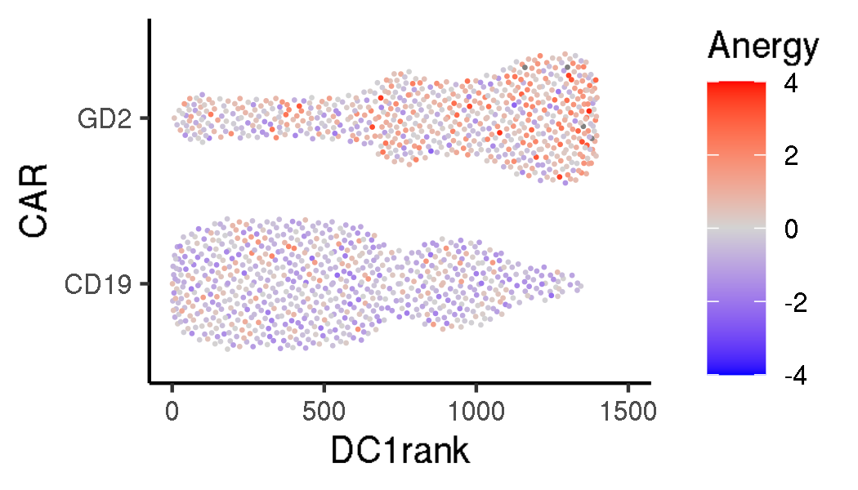
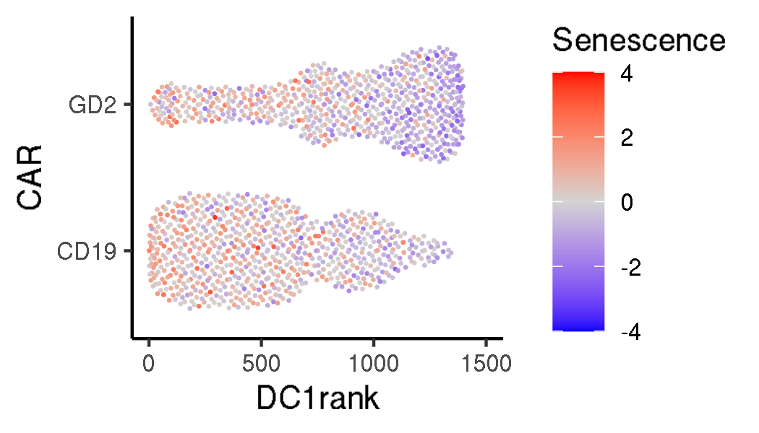
GSE136874: comparison of CD19 and GD2 CAR T cells on day 10 in culture
Transition plots

Slide 9
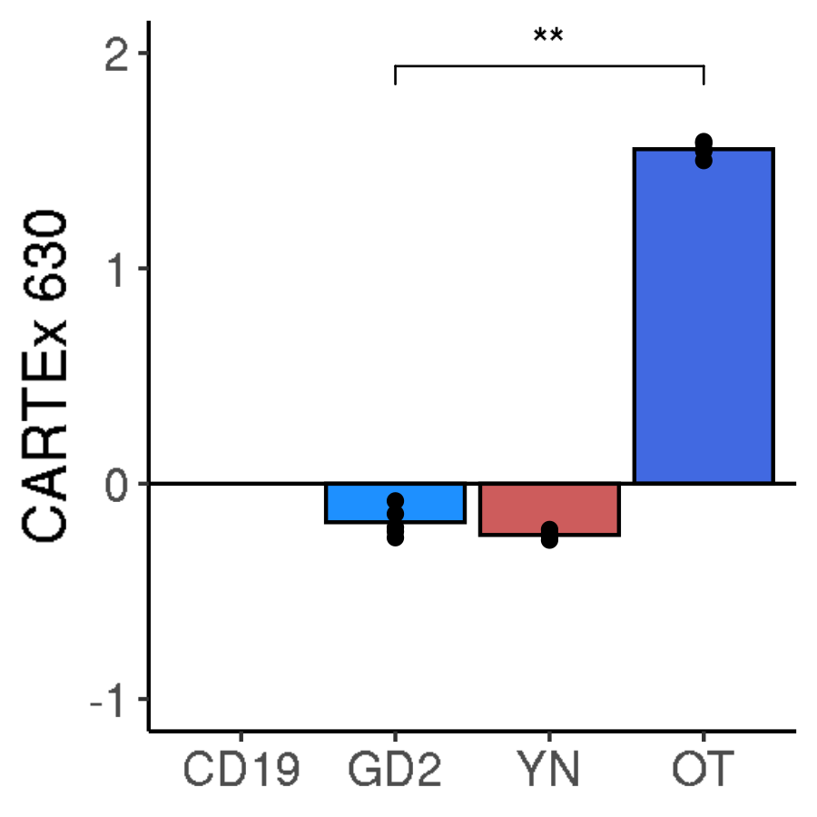
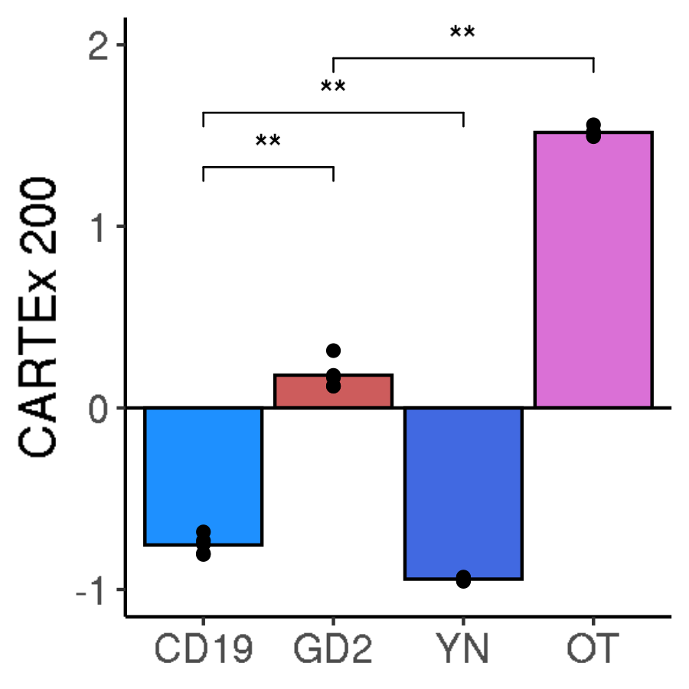
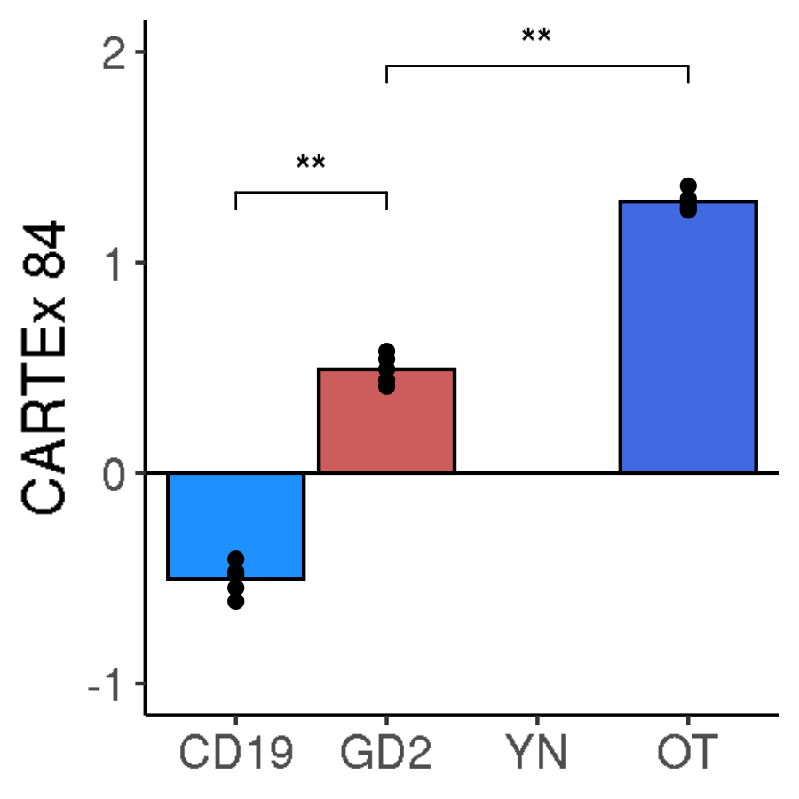
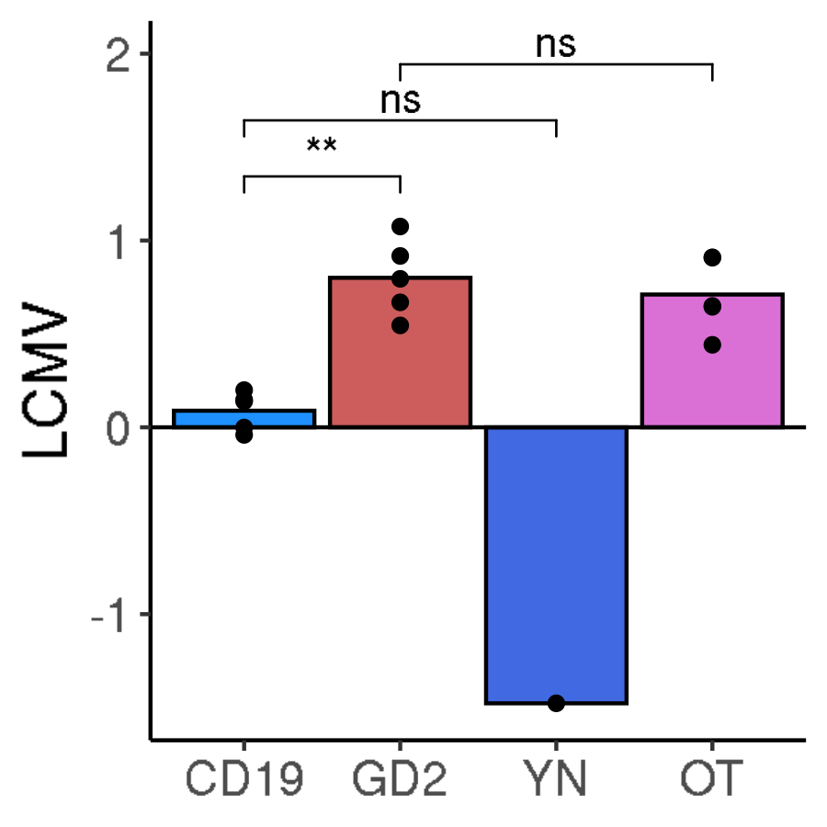
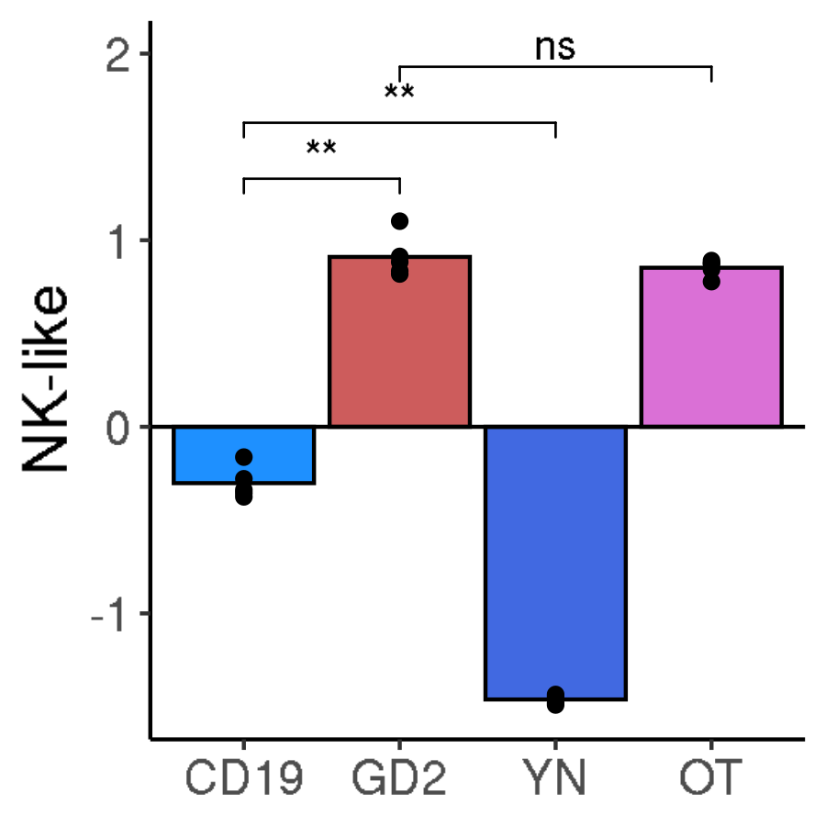
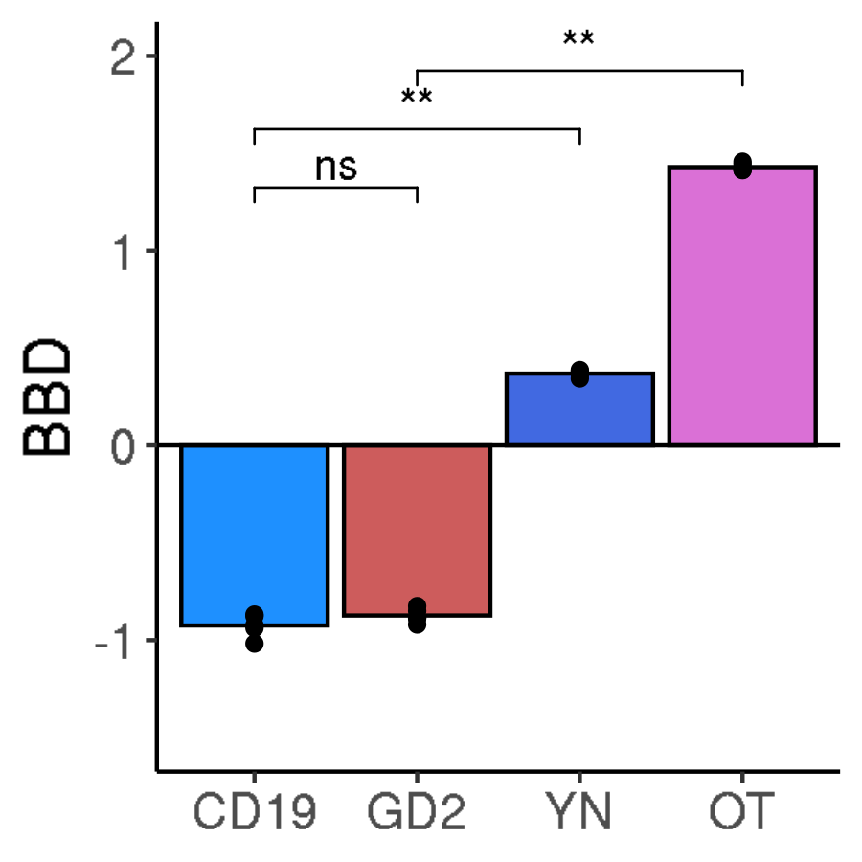
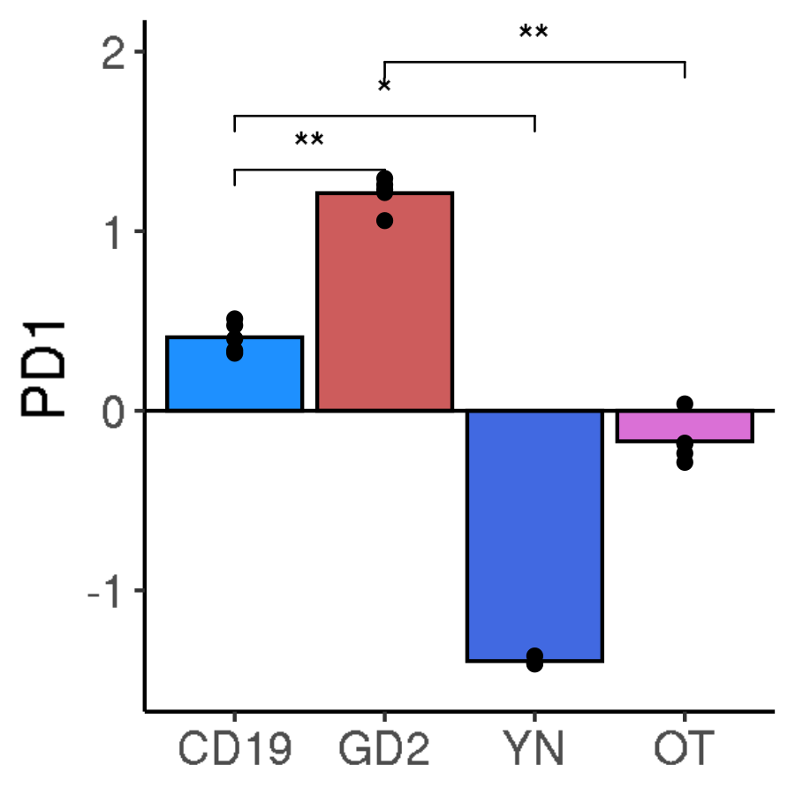
GSE136874: comparison of CD19 and GD2 CAR T cells on day 10 in culture
Pseudo-bulk exhaustion scores

Slide 10
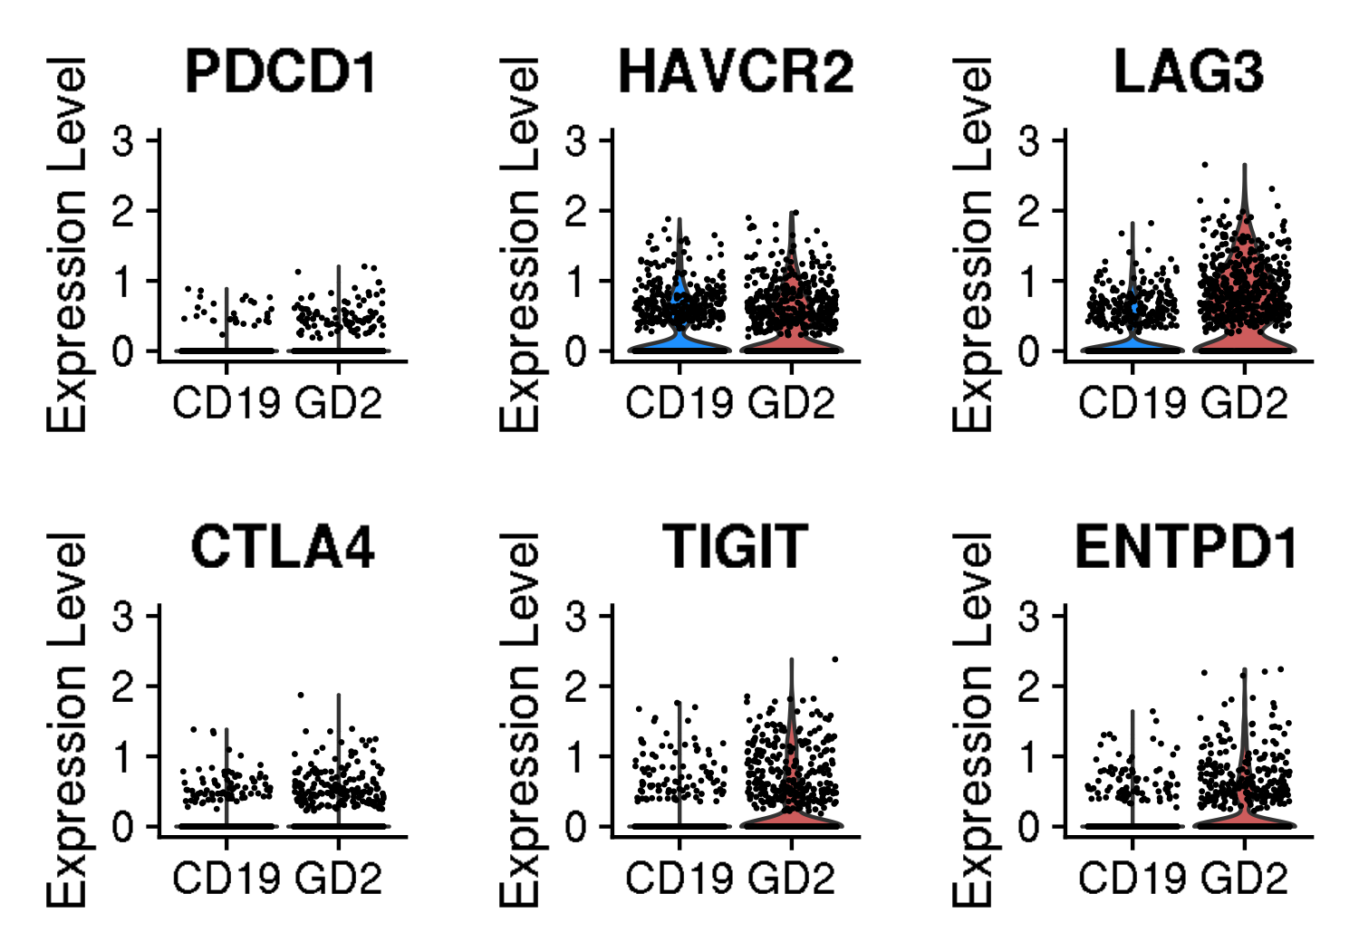
GSE136874: comparison of CD19 and GD2 CAR T cells on day 10 in culture
Violin plots for canonical exhaustion markers
Gene and corresponding protein
PDCD1 encodes PD-1
HAVCR2 encodes TIM-3
LAG3 encodes LAG-3
CTLA4 encodes CTLA-4
TIGIT encodes TIGIT
ENTPD1 encodes CD39

